Slide 1
DIFFERENTIALLY PRIVATE RECOMMENDER SYSTEMS
BY MEGAN SKROBACZ AND RAAGHAVV DEVGON

Slide 2


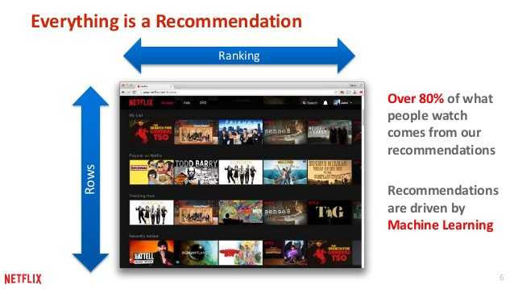
WHAT IS A RECOMMENDER SYSTEM?
A MECHANISM THAT ATTEMPTS TO PREDICT AND RECOMMEND CONTENT YOU MAY LIKE BASED ON DATA FROM YOU AND OTHER USERS
Image credit: https://rpubs.com/dhnanjay/286571

Slide 3
HOW CAN WE MAKE OUR RECOMMENDER SYSTEM DIFFERENTIALLY PRIVATE?
FIRST, LET’S TALK ABOUT THAT THAT MEANS.

Slide 4
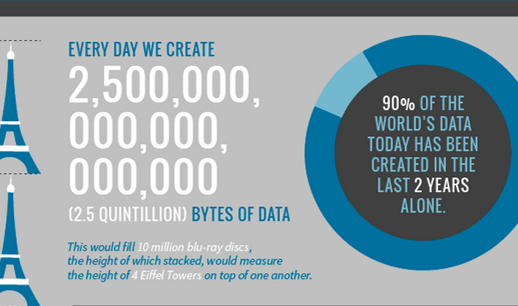
WE LIVE IN A DATA-DRIVEN WORLD
Image credit: https://wonderfulengineering.com/this-is-the-amount-of-data-that-is-being-generated-in-the-world-every-minute/

Slide 5

WHAT MAKES UP PERSONAL DATA?
Explicit identifiers – directly point to you
Quasi identfiers – can be used to identify you when compared with other data
Sensitive information – data you may not want public
Non-sensitive information – general information about you
Together, there are known as Personally Identifiable Information, or PIIs
Image credit: Sohu.com

Slide 6

YOUR PERSONAL DATA SHOULD BE PROTECTED
Depending on where you live, there are certain laws in place which mandate privacy
How do data holders actually make this happen?
Image credit: https://miro.medium.com/max/1400/1*sZ8SxNEJekT5clQLYy3OuA.jpeg

Slide 7
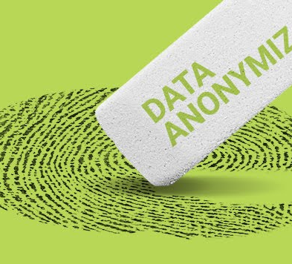
ANONYMIZATION
THE PROCESS OF EITHER REMOVING OR GENERALIZING PERSONAL INFORMATION FROM A DATASET, WITH THE HOPE THAT NON-SENSITIVE, OR “PROTECTED”, DATA CAN BE SENT WITHOUT FEAR OF THE PERSONAL IDENTITIES OF THE PARTICIPANTS BEING IDENTIFIED BY THOSE ANALYZING THE DATA
Image credit: https://www.solarwindsmsp.com/blog/data-anonymization-overview

Slide 8
SO WHAT’S THE PROBLEM?

Slide 9
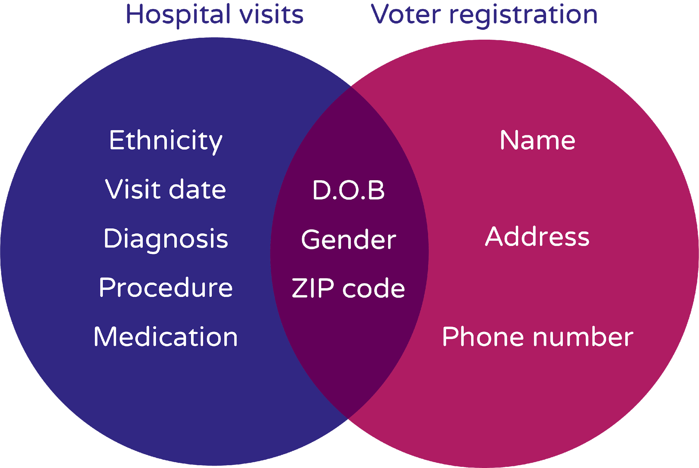
THE PROBLEM WITH ANONYMIZATION
Linkage attacks - attempts to re-identify individuals in an anonymized dataset by combining that data with another dataset
Linkage attacks are powerful because seemingly innocuous attributes often suffice to uniquely identify an individual when compared to anonymized PIIs
Image credit: https://www.privitar.com/blog/solve-big-data-privacy/

Slide 10
THE PROBLEM WITH ANONYMIZATION
Context can de-anonymize a dataset
Postcode | Gender | Area of Treatment
***12 | Male | Liver
***98 | Female | Digestive
***02 | Female | Respiratory
***02 | * | Digestive
***16 | Male | Digestive
***17 | Female | Cardiovascular
***98 | * | Digestive

Slide 11

THE PROBLEM WITH ANONYMIZATION
Differencing attacks – comparing and contrasting two queries to indirectly zero in on the data you are looking for
Auditing the possible combinations of queries is a task that is infeasible, as it would lead to thousands or even millions of potential combinations.
Image credit: https://www.privitar.com/blog/differencing-attacks/

Slide 12
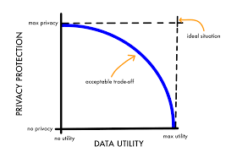
THE PROBLEM WITH ANONYMIZATION
The more you anonymize, the less useful your data becomes
Even non-sensitive data can be used for harm
Image credit: https://support.sas.com/resources/papers/proceedings15/1884-2015.pdf

Slide 13
SO WHAT CAN WE DO???

Slide 14





THIS IS WHERE DIFFERENTIAL PRIVACY COMES IN
A property of the algorithm querying the data, not the data itself
A more general approach
A fairly new approach
Has been recently utilized in big datasets – 2020 Census as an example

Slide 15
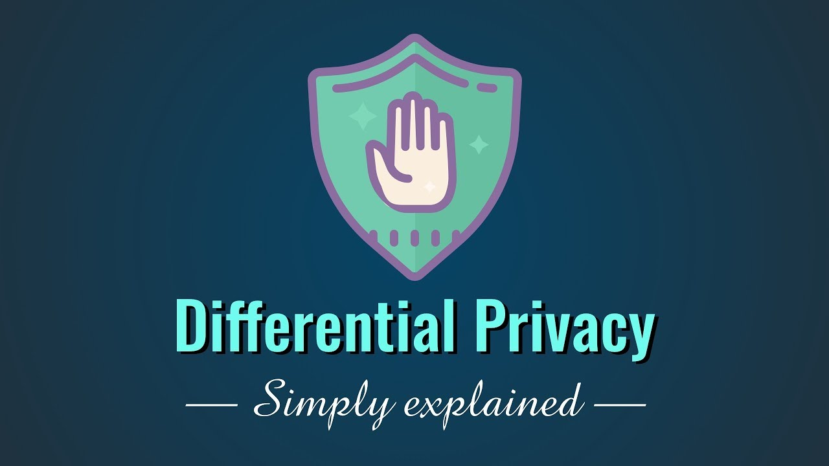
BUT WHAT IS DIFFERENTIAL PRIVACY?
Image credit: https://www.youtube.com/watch?v=gI0wk1CXlsQ

Slide 16
DEFINITION OF DIFFERENTIAL PRIVACY
A differentially private algorithm promises that the probability of a bad event (e.g. privacy compromised) increases by only a small multiplicative amount when an individual’s data is added to the database
You are protected because statistically, it’s almost impossible for a potential attacker to determine if you’re even in the dataset at all – and if it’s impossible to tell if a person is even included in the data, then any analysis you do of the data is meaningless.

Slide 17




A SIMPLE EXAMPLE OF DIFFERENTIAL PRIVACY - JOE
Let’s say we have a database of a million entries, and an attacker wants to learn about Joe
The attacker will have to contend with the fact that Joe’s data might not even be in there at all when he runs a query
Any analysis of the data he might do to find Joe’s specific data is meaningless, because there’s a chance he’s not the results at all
However, the results will still be usable as for data analysis by non-attackers

Slide 18
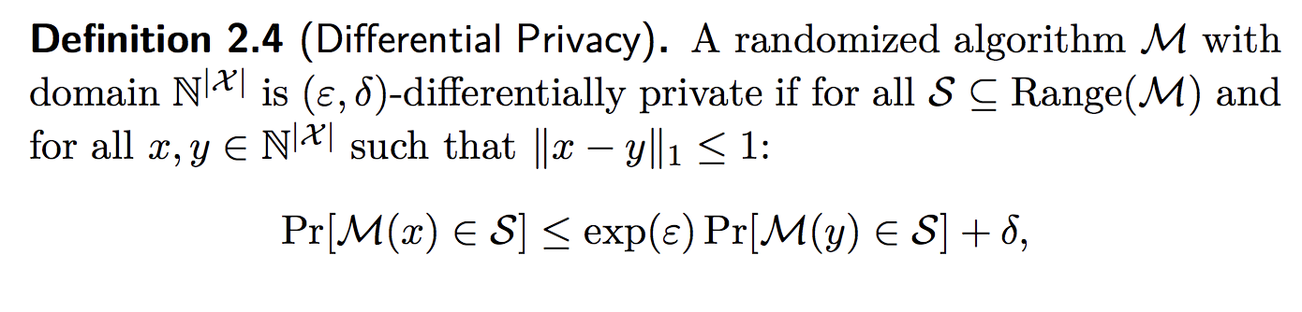
DIFFERENTIAL PRIVACY – THE MATHEMATICAL PREMISE

Slide 19
WHAT….?
THAT’S PROBABLY WHAT YOU THOUGHT AFTER SEEING THIS MATH EQUATION.
LET’S EXPLAIN!

Slide 20
DIFFERENTIAL PRIVACY – THE MATHEMATICAL PREMISE
Breaking down the variables:
Pr = probability
M() = the differentially-private algorithm, being applied to dataset x and dataset y, which only differ by one entry (in our previous example, Joe vs no Joe)
S = the result of our query
ε = the privacy budget; a smaller ε will mean the algorithm is more private
∂ = a small constant
The probability of getting a specific output from a function on one dataset should be about the same when applied to another dataset with a single entry removed.

Slide 21
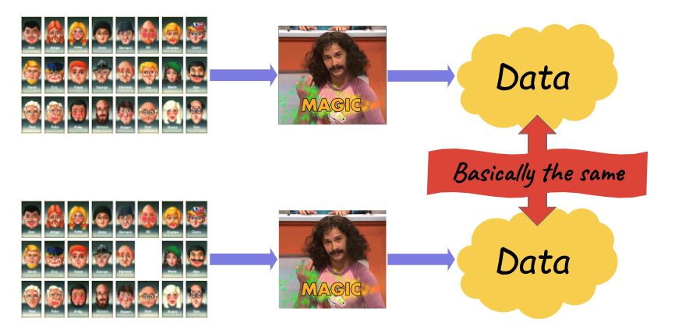
SO HOW EXACTLY DOES THIS WORK?
Image credit: https://desfontain.es/privacy/differential-privacy-awesomeness.html

Slide 22

THE MAGIC OF ADDING NOISE
Noise = something that is added to the results, in some form or fashion, in order to mask the true value of that data
Results of a differentially-private algorithm = true results + noise
Adding noise adds an element of plausible deniability that the results are 100% accurate

Slide 23
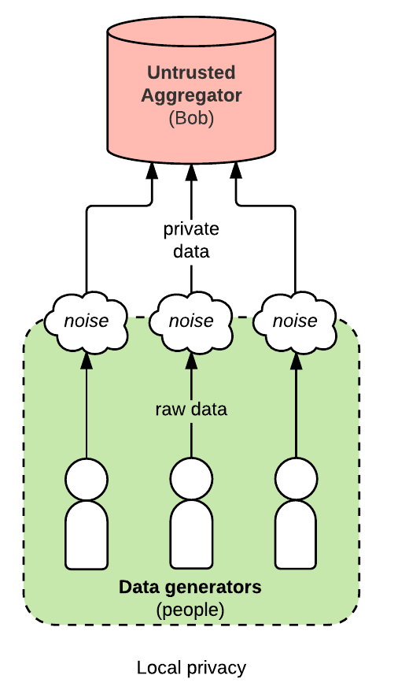
HOW NOISE IS ADDED LOCALLY
When added locally, the noise is added by a differentially-private algorithm at the time of data collection
This tactic could be useful if the aggregator of the data is untrusted or prone to security breaches
This means that the individual data in a database could be accurate, or not – so even if you have a single person’s data, there’s a chance the results aren’t the truth and thus personal privacy is protected
Image credit: Bennett Cyphers

Slide 24
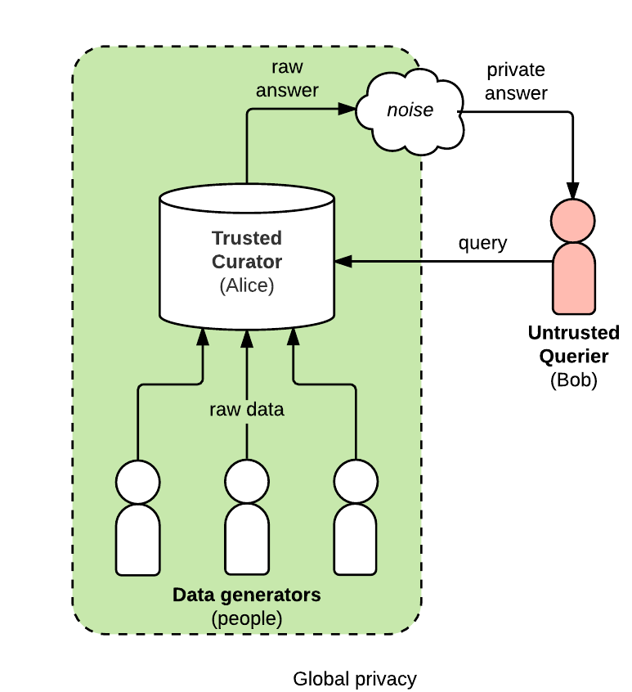
HOW NOISE IS ADDED GLOBALLY
When added globally, the noise is added by a differentially-private algorithm at the time the data is queried
This tactic could be useful if the querier of the data is untrusted, but the aggregator can be trusted with accurate data and to run differentially-private algorithms when a query is requested
Image credit: Bennett Cyphers

Slide 25
HOW DO WE FIGURE OUT HOW MUCH NOISE TO ADD?
THERE ARE MANY METHODS, BUT FOR OUR RECOMMENDER SYSTEM, WE ARE GOING TO USE THE LAPLACE MECHANISM

Slide 26
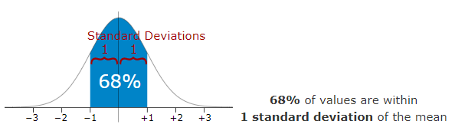
A STANDARD DISTRIBUTION
Standard deviation = a measure of the amount of variation or dispersion of a standard distribution of values
Most values fall within a single standard deviation of the mean
Notice the shape of the curve
Notice that it centers around zero
Image credit: https://www.mathsisfun.com/data/standard-deviation.html

Slide 27
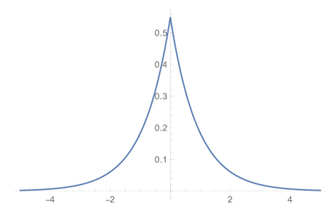
A LAPLACE DISTRIBUTION
A measure of how much noise to add to a piece of data
The absolute value of a Laplace random variable is an exponential random variable
Like a standard distribution, it has a similar shape and is centered around zero
Image credit: https://desfontain.es/privacy/differential-privacy-in-practice.html

Slide 28
WHY DOES THIS MATTER?
Because the Laplace Distribution has the same magnitude as a standard distribution, it is similarly reliable when applied to datasets (i.e. it applies to the majority of values in a dataset)
Because the Laplace distribution is centered around zero, chances are the noise it adds will be close to zero and thus the data itself will be relatively accurate for data analysis

Slide 29
THE LAPLACE MECHANISM
The Laplace Mechanism adds Laplacian-distributed noise to a function
It is calculated using the sensitivity (Δs) of a dataset, as well as the privacy budget (ε) of the differentially-private algorithm
Sensitivity = how much the results of the data would change (without noise) if a single entry was removed from the dataset
Adding Laplace noise with scale Δs/ε preserves ε-differential privacy.

Slide 30
AGAIN, WHAT….?
MATH IS HARD.
LET’S DO AN EXAMPLE!

Slide 31
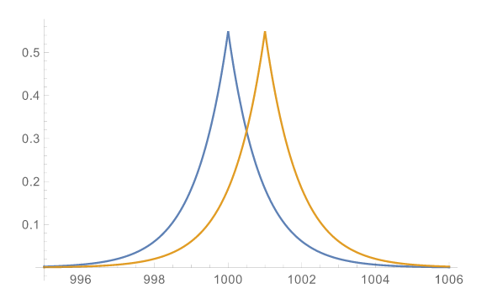
“HOW MANY PEOPLE HAVE GREEN EYES?”
The sensitivity of this query would be 1, since removing 1 person could, at most, change the results by 1
To get ε-differential privacy, we pick a random value according to Laplace(1/ε), and we add this noise to the real value (k)
After adding noise, we spit out 1003, even though k is really 1001 (i.e. we add a noise of 2)
What's the likelihood that the real number was 1001 vs. 1000? The hypothesis "k=1001" is a bit more likely: generating a noise of 2 is more likely than a noise of 3
It turns out that the ratio between these likelihoods is… e^{ε}, i.e. exp(ε), or ε-differentially private
Blue line k=1000
Orange line k=1001
Image and example from: https://desfontain.es/privacy/differential-privacy-in-practice.html

Slide 32
OKAY, SO NOW WE KNOW WHAT DIFFERENTIAL PRIVACY IS, AND HOW TO ADD NOISE
THE STAGE IS NOW SET FOR OUR DIFFERENTIALLY-PRIVATE RECOMMENDER SYSTEM

Slide 33
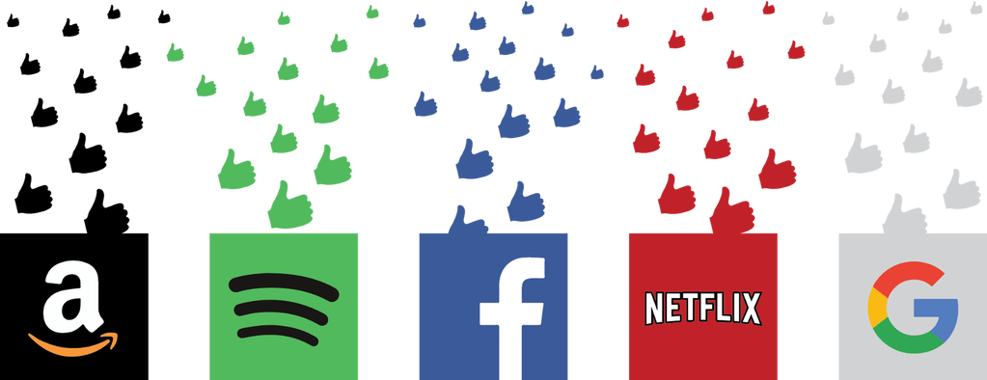
RECOMMENDER SYSTEMS – A RECAP
Why is such a system required?
Who uses it?
Types of Recommendation systems:
Context-Based System
Collaborative System
Hybrid System
Image credit: https://thedatascientist.com/right-way-recommender-system-startup/

Slide 34
COLLABORATIVE BASED SYSTEMS
Collaborative filtering has many forms, but many common systems can be reduced to two steps:
Look for users who share the same rating patterns with the active user (for whom the prediction is for)
Use the ratings from the like-minded users found in the previous step, to calculate a prediction for the active user.
This falls under the category of user-based collaborative filtering.

Slide 35

COLLABORATIVE BASED SYSTEMS
This type of a recommendation system has a huge potential gain in improving user experience
Takes aggregate data from all users
Most susceptible to a privacy-based attack:
Linkage Attack
Deanonymization Attack
Image credit: Harvard Graduate School of Education

Slide 36

PRIVACY RISKS WITH COLLABORATIVE SYSTEMS
Narayan and Shmatikov - deanonymization attack linking records with public data set with public IMDb profiles.
Possible to create a fake profile (or many), resembling an individual based on the attacker’s partial knowledge and induce the recommender system to report the items highly rated by the user.
Image credit: IMDb

Slide 37
HOW TO TACKLE THIS PROBLEM ?
WELL, BY USING DIFFERENTIAL PRIVACY!!

Slide 38

DIFFERENTIALLY PRIVATE RECOMMENDATION SYSTEMS
For this purpose we will be demonstrating a practical implementation of the recommendation system.
We have used MovieLens database which is available online.
The challenge is to see if the system gives good recommendations after making the data differentially private.
Image credit: https://miro.medium.com/max/1400/1*rTZvrFD258ZZwvGy7nyqDw.jpeg

Slide 39
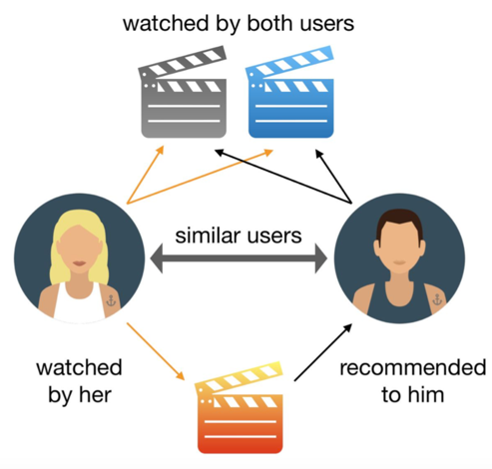
DIFFERENTIALLY PRIVATE RECOMMENDATION SYSTEMS
Preprocess the dataset.
Add the noise to the ratings.
Develop a correlation matrix
Get similar movies based on the type of movies the user likes.
Deliver the results
Image credit: Quora.com

Slide 40
AGAIN, WHAT….?
Turns out Machine Learning is hard too...
LET’S HELP VISUALIZE THIS!!

Slide 41
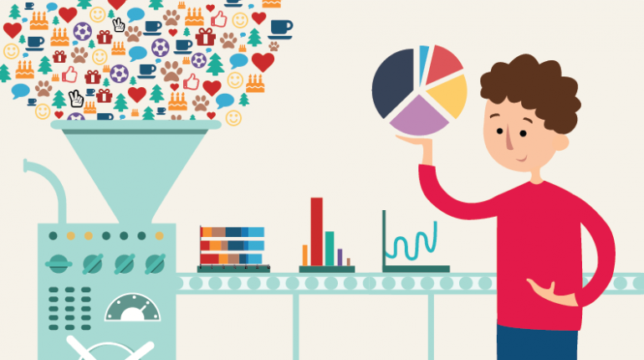
STEP 1: PRE-PROCESS THE DATA
First drop the ratings which are not available aka ‘NA’
Reduce the data set, by keeping the rating of only those users who’ve rated more than 10 films
This helps us clean the data and deliver more accurate results
Image credit: Analytics India Magazine

Slide 42
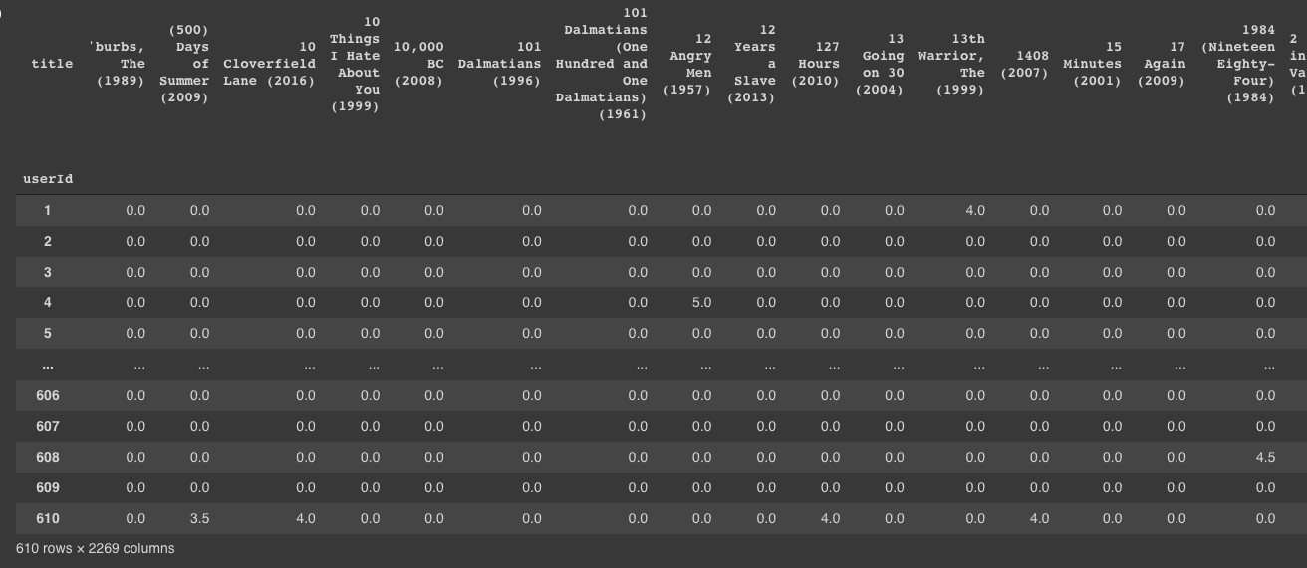
DATASET WITHOUT THE NOISE

Slide 43

STEP 2: ADD NOISE
For each element in the dataframe we add a random value to each element inside the dataframe
The random value, has been selected as per the laplace distribution.
Based the dataset in contention, we tried multiple selections of epsilon and sensitivity to get the best result.
Epsilon =2, Sensitivity =1

Slide 44
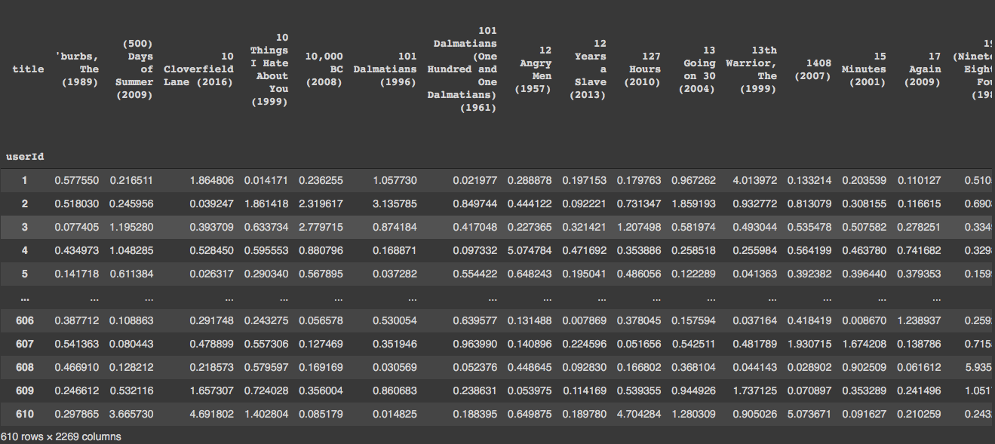
DATASET AFTER THE NOISE

Slide 45
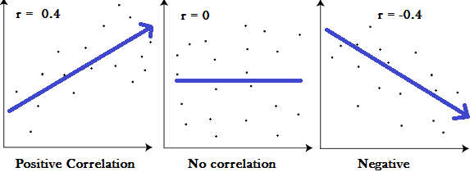
STEP 3: CREATE A CORRELATION MATRIX
What is a correlation?
It is useful in data analysis and modelling to understand the relationships between variables.
A correlation can be:
Positive: Both variables change in the same direction
Neutral: No relationship between the change of the variables
Negative Correlation: Variables change in opposite directions.
Image credit: StatisticsHowTo.Com

Slide 46
STEP 3: CREATE CORRELATION MATRIX
For this implementation we will be using Pearson’s Correlation
Pearson Correlation can be used to summarize the strength of the linear relationship between the two data samples
It can be calculated as the covariance of the two variables divided by the product of the standard deviation of each data sample.
It is the normalization of the covariance between the two variables to give an interpretable score.

Slide 47
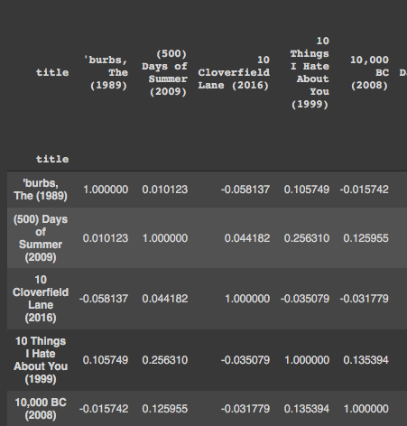
CORRELATION MATRIX

Slide 48
STEP 4: GETTING THE RECOMMENDATIONS
The user gives a the movie name and the rating it wants to give:
For example : [("Toy Story 3 (2010)",4),("Ratatouille (2007)",4)]
2. For each movie in the list, we will get the similar movies.
3. The similar movies are generated as follows:
We select the movie’s column from the correlation matrix.
The rating submitted by the user, is subtracted by average rating (2.5 as mentioned in the research paper) and multiplied to the correlation matrix value received.
We sort the column and return the films and their ratings.

Slide 49
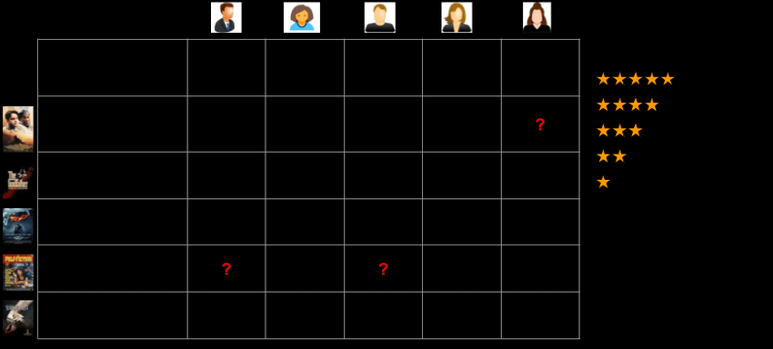
STEP 4: GETTING THE RECOMMENDATIONS
Each of these similar movies and ratings are appended in a dataframe.
We will perform these steps till all the user’s movies are iterated upon.
Image credit: ResearchGate.com

Slide 50
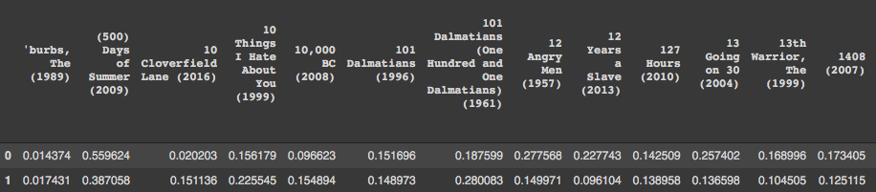
STEP 4: GETTING THE RECOMMENDATIONS

Slide 51
STEP 4: GETTING THE RECOMMENDATIONS
The result doesn’t make sense right now, so we will sum all the values and sort them.
In this case, as our user really liked animation movies, we expect to see animation movies recommended to him.
Let’s see our results…..

Slide 52
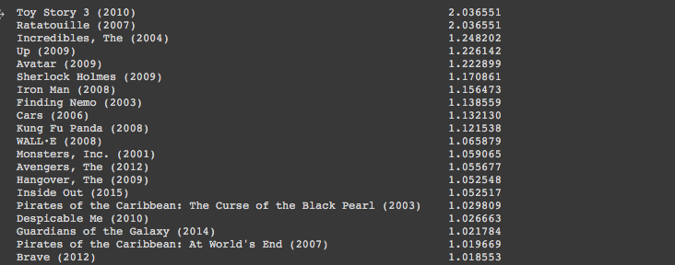
STEP 5: DELIVER THE RESULTS

Slide 53
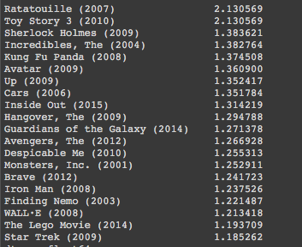
SIDE BY SIDE COMPARISON: DIFFERENTIALLY PRIVATE SYSTEM VS NORMAL SYSTEM

Slide 54
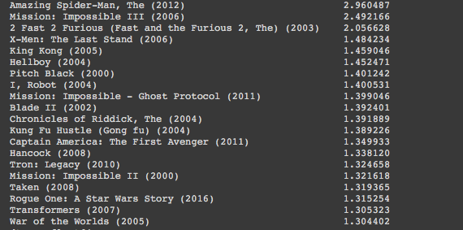
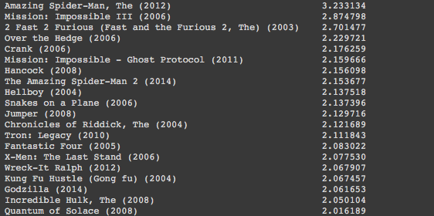
SIDE BY SIDE COMPARISON: DIFFERENTIALLY PRIVATE SYSTEM VS NORMAL SYSTEM
For the query by a user who likes action-adventure movies.
action_adv = [("Amazing Spider-Man, The (2012)",5),("Mission: Impossible III (2006)",4),("Toy Story 3 (2010)",2),("2 Fast 2 Furious (Fast and the Furious 2, The) (2003)",4)]

Slide 55
FINAL RESULTS
Based upon our findings we can state that using a differentially private recommendation system provided us very good recommendations, while preserving user privacy.
In some queries we received better results as compared to the results from normal collaborative recommendation system
We believe using a differentially private recommendation engine could prevent the system from attacks such as deanonymization attacks

Slide 56
FUTURE SCOPE
There can be scope of using a better epsilon or sensitivity value to get accurate results
We also think there can be more ways to add noise: such as using exponential noise.
Our implementation was inspired from the research paper: Differentially Private Recommender Systems: Building Privacy into the Netflix Prize Contenders by Ilya Mironov and Frank McSherry.

Slide 57
REFERENCES
https://www.microsoft.com/en-us/research/publication/differentially-private-recommender-systems-building-privacy-into-the-netflix-prize-contenders/?from=http%3A%2F%2Fresearch.microsoft.com%2Fpubs%2F80511%2Fnetflixprivacy.pdf
Code Heroku: https://www.youtube.com/watch?v=3ecNC-So0r4
https://www.cs.utexas.edu/~shmat/shmat_oak08netflix.pdf

Slide 58
Thanks for watching!
Now go binge-watch some movies.
You know you want to.

